Slide 1
ETHICAL HACKING
TASK 2

Slide 2
NETSPARKER FOUND VULNERABILITIES

Slide 3
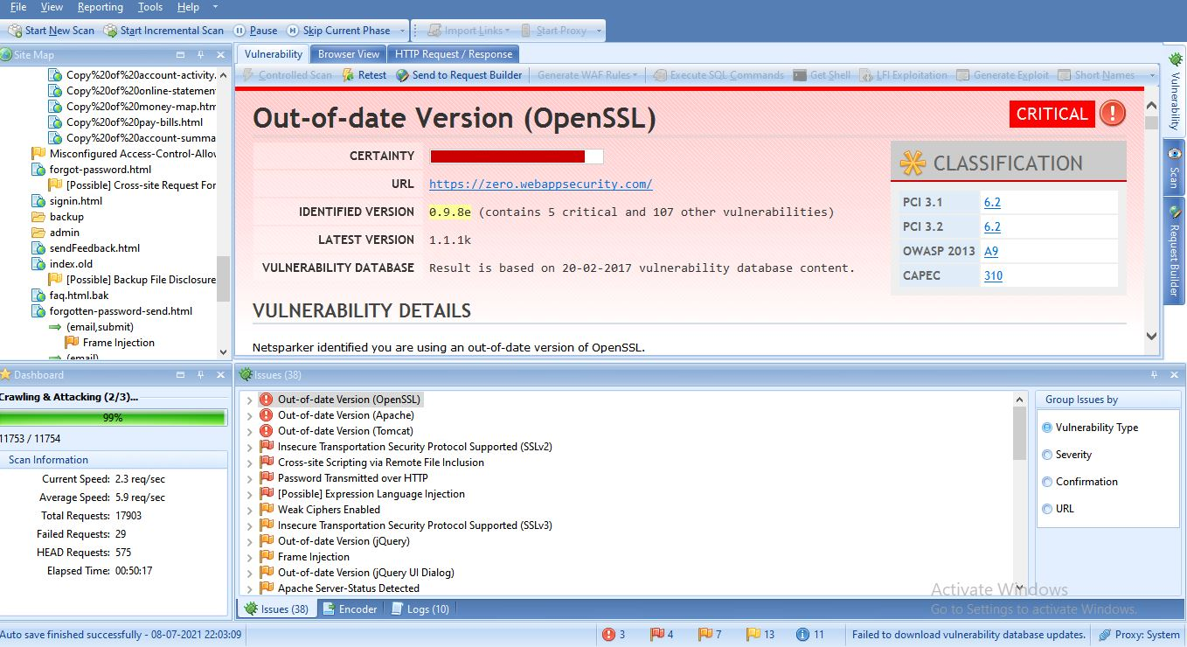
NETSPARKER FOUND VULNERABILITIES

Slide 4
NETSPARKER REPORT

Slide 5
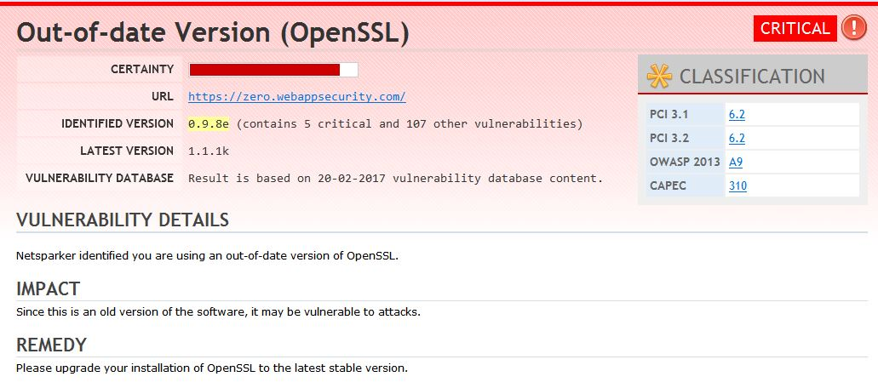

Slide 6
WRITTEN REPORT

Slide 7
